Slide 1
"Digital Media Primer" Yue-Ling Wong,
Copyright (c)2013 by Pearson Education, Inc. All rights reserved.

Slide 2
Chapter 3
Capturing and Editing Digital Images
Part 8
Vector Graphics

Slide 3
In this lecture, you will learn:
what make up a vector graphic object
what are paths, anchor points, direction handles, strokes, fills
the common tools to create and edit vector graphics
how to adjust the curviness and tangent of a path

Slide 4
Vector Graphics
Objects and shapes made up with paths, points, strokes and fills
Not pixel based

Slide 5
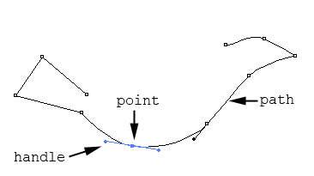
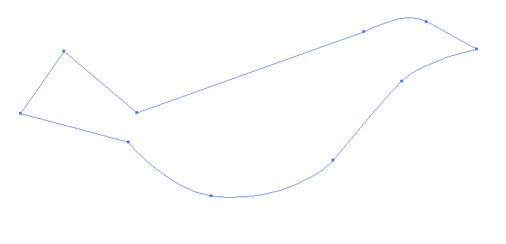
Paths
open path
closed path

Slide 6
Paths and Points
A mathematical description of an abstract line or curve
Defined by a set of points, called anchor points

Slide 7
Tangent and Curviness
Each point has direction handles or tangent handles.
Handle's angle: tangent at the point
Handle's length: curviness at the point

Slide 8
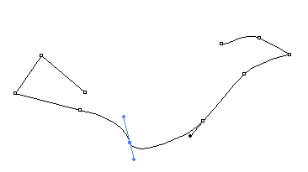
Angle of Handle: Tangent

Slide 9
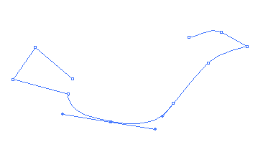
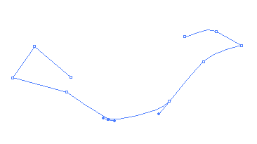
Length of Handle: Curviness
Longer handle
Curvier at the point
Shorter handle
More angular at the point

Slide 10
Corner Points vs. Smooth Points
Corner point:
  appears sharp and angular
  handles have zero length
  used for creating straight segments
  In vector graphic programs, a corner point does not have handles.
Smooth point:
  has direction handles to let you adjust the tangent and curviness at the point

Slide 11
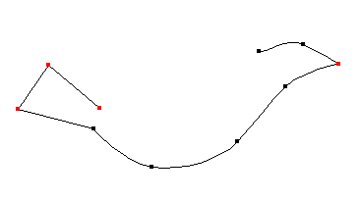
Corner Points vs. Smooth Points
smooth point
corner point
smooth point
corner point
corner point
corner point
smooth point
smooth point
smooth point
smooth point

Slide 12
Common Tools in Adobe Illustrator

Slide 13
Tools to Create Paths
Pen tool:
Simple click: Corner point
Hold the mouse and drag:
Drag out a handle to create a smooth point

Slide 14
Tools to Convert between a Smooth Point and a Corner Point
Convert Anchor Point tool:
Click on a point to convert it into a corner point
Click-drag on a point to drag out a handle, making it a smooth point

Slide 15
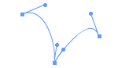
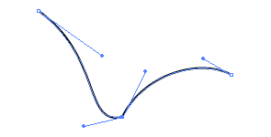
Breaking Dependency of Handles
A handle has two sides
Each side can be adjusted separately
ALT-drag (Windows) or Option-drag (Mac OS) on one of the handles to break their dependency

Slide 16


Practice drawing a simple path by using Pen tool, Convert Anchor Point tool, adjusting handles, and breaking dependency of handles.
Also try out the Activity described in the book:
DRAWING PATHS WITH PEN TOOL

Slide 17
Strokes
A path does not have a physical appearance--line width or color--until the path is stroked with a specified line style, width, and color

Slide 18
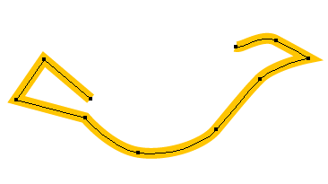
Strokes
A path without stroke.
It will not be printed.
It will not show up during the editing unless you select the path.
A path stroked with orange line

Slide 19
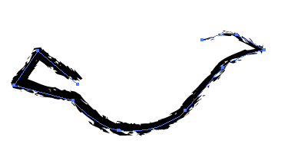
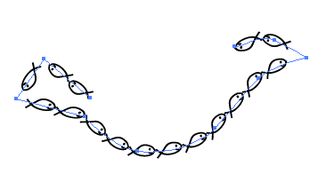
Strokes
The path stroked with a line of charcoal brush style
The path stroked with a line of custom brush style of a small fish

Slide 20
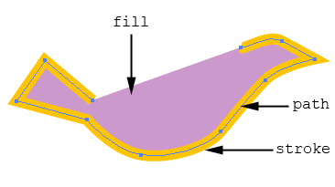
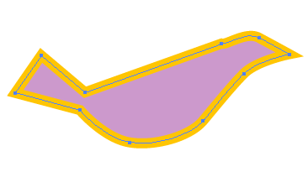
Fill
A color, pattern, or gradient inside a shape defined by a path
Can be applied to open and closed paths

Slide 21
Preset Shapes and Free-Form Drawing
Preset shape drawing tools:
  ellipses
  rectangles
  polygon
  stars
  spirals
Free-Form drawing tool:
  draw a freeform path with a continuous stroke without manually defining the points
  a freeform path is still made up of points

Slide 22
Selection Tools
Selection tool
  select a whole object
Subselection or Direction Selection tool
  select the points and handles

Slide 23
Other Useful Features
Layers
Effects
Filters

Slide 24
Review Questions
Note to instructor:
Depending on your preference, you may want to go over the review questions at the end of this lecture as an instant review or at the beginning of next lecture to refresh students' memory of this lecture.

Slide 25
Review Question
A path does not have physical appearance until ___.
Notes:
it is stroked with a specified line style, width, and color

Slide 26
Review Question
Matching:
path
fill
stroke
(i)
(ii)
(iii)
Notes:
A – (ii)
B – (i)
C – (iii)

Slide 27
Review Question
Fill in the blanks with 2 of these words:
path stroke fill curviness tangent width
color
The handle's length controls the ___ at the point and the handle's angle controls the ___ at the point.
Notes:
curviness
tangent

Slide 28
Review Question
Which of the following apply to corner points?
appear sharp and angular
used for creating straight segments
handles have zero length
have direction handles to let you adjust the tangent and curviness at the point
Notes:
A, B, and C

Slide 29
Review Question
Which of the following apply to smooth points?
appear sharp and angular
used for creating straight segments
handles have zero length
have direction handles to let you adjust the tangent and curviness at the point
Notes:
D

Slide 30
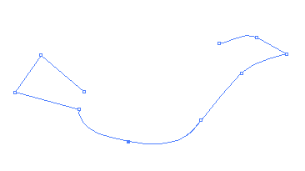
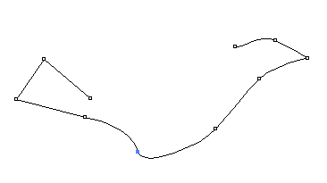
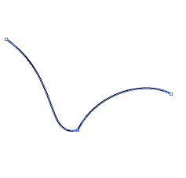
Review Question
Which point's handle dependency is broken?
A
B
C
Notes:
C

Slide 31
Review Question
The Selection tool let you select ___.
the whole object
the points and handles on a path
Notes:
A

Slide 32
Review Question
The Subselection or Direct Selection tool let you select ___.
the whole object
the points and handles on a path
Notes:
B

Slide 33
Review Question
True/False: When you use the free-form drawing tool to draw a path, it is not made up of anchor points any more.
Notes:
False

